Slide 1

Blockchain
Implementation using java✔
24.11.2020

Slide 2


Agenda
INTRODUCTION
INFORMATION
ADVANTAGES
IMPLEMENTION
MODEL
JAVA PACKAGES
JAVA CODE
CONCLUSION
REFERENCE
CLOSING

Slide 3

INTRODUCTION
🐱‍👤MEMBERS 🐱‍💻
Vikrant V Joliya :9919004368
Kunal Vasudeven :9919004153
Jayachandrapal :9919004082

Slide 4

Blockchain as a Solution 👀🐱‍🚀
A Blockchain is a list of records called blocks that are linked together using linked lists and use the cryptographic technique.
Each block contains its own digital fingerprint called Hash, the hash of the previous block, a timestamp and the data of the transaction made, making it more secure towards any kind of data breach.

Slide 5
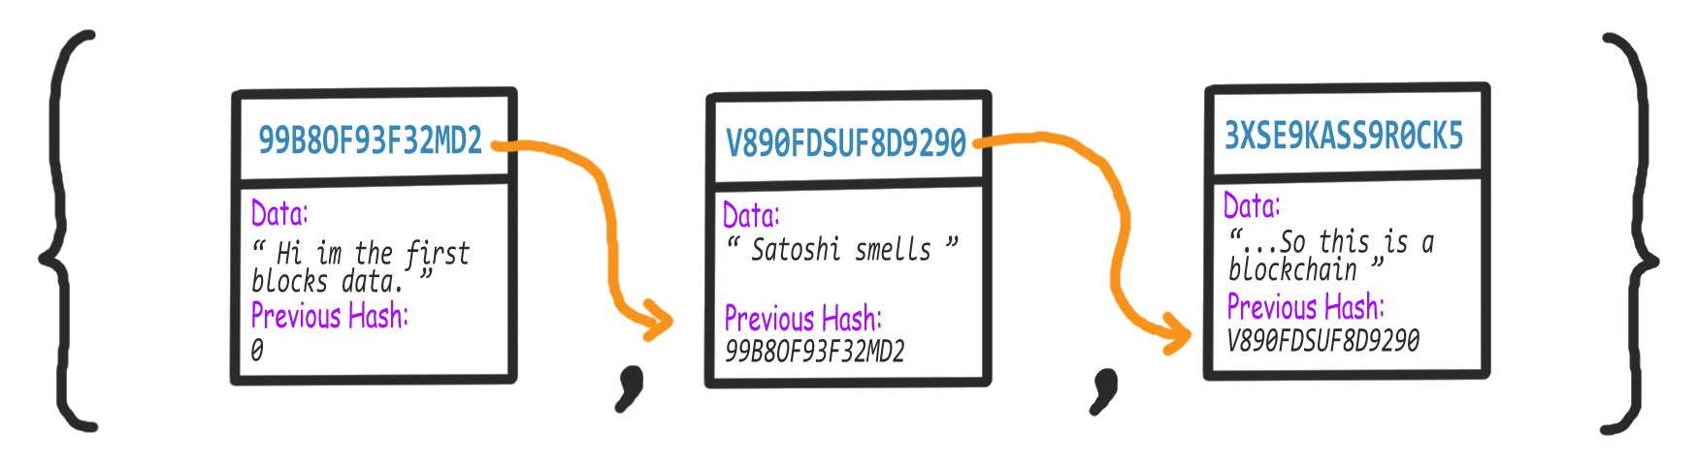

Slide 6
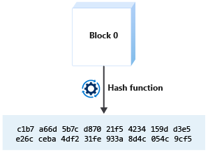
How can you trust the ledger is immutable?
Blockchain uses a cryptographic hash to create link between blocks. By linking blocks, the order of transactions can be agreed upon through the consensus algorithm.
A cryptographic hash is an algorithm that maps data of an arbitrary size to a bit representation of fixed size. You can think of it as a digital fingerprint.

Slide 7
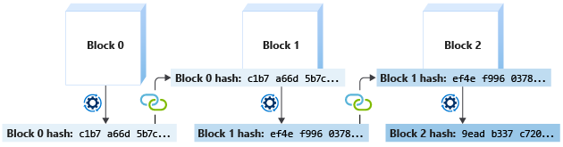
Continued…
Bitcoin uses the SHA-256 hash algorithm. If you used a SHA-256 hash function on a 100 page document, the function output is a 256-bit hash value.
If you changed just one character in the document and regenerated the hash, the output is a different 256-bit hash value.
Now, imagine if we use a block as the input to the hash function. The output is a unique hash value for the data in the block.

Slide 8

What’s next🏆
LOOKING advantages
Blockchain is a distributed network of systems. Therefore, data breaches are very difficult to be carried out.
Since, Blockchain generated hashes of each block, therefore, it is very difficult to carry out malicious attacks.
Data Tampering will change the hash of each block which will make the blockchain invalid

Slide 9

How we can Implement Blockchain🔗
🧱 CREATING BLOCKS🧱
🔒GENERATING HASHES🔑
📦STORING THE BLOCKS🗃
✔BLOCKCHAIN VALIDITY❌

Slide 10
🦺Model🛠
Block
Hashing
Storing
Validity

Slide 11
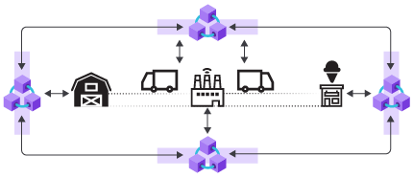
SUMMARY🎞
Creating Blocks: To create a block, a Block class is implemented
Generating Hashes: To generate hash, SHA256 algorithm is used.
Storing the blocks: Now, let us store the blocks in the ArrayList of Block type, along with their hash values by calling the constructor of the Block Class.
Blockchain Validity: Finally, we need to check the validity of the Blockchain by creating a Boolean method to check the validity. This method will be implemented in the “Main” class and checks whether the hash is equal to the calculated hash or not. If all the hashes are equal to the calculated hashes, then the block is valid.

Slide 12
🎁JAVA PACKAGES
java.nio.charset.StandardCharsets.
java.security.MessageDigest.
java.security.NoSuchAlgorithmException.
java.util.Base64.
java.util.Date.
java.util.ArrayList.
java.util.List.

Slide 13
Block.java
………………………..

Slide 14
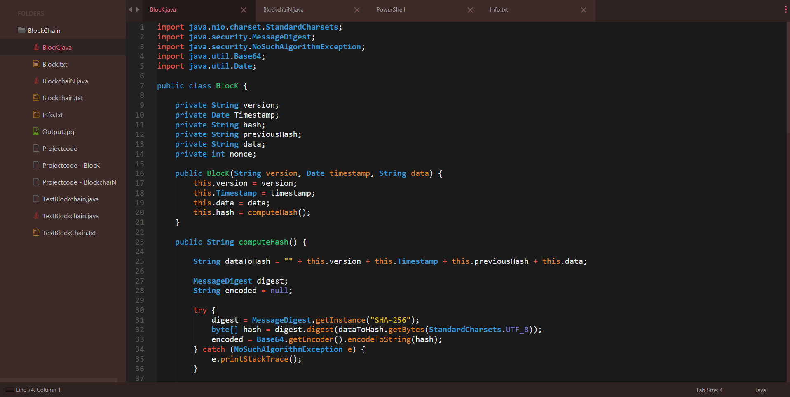

Slide 15
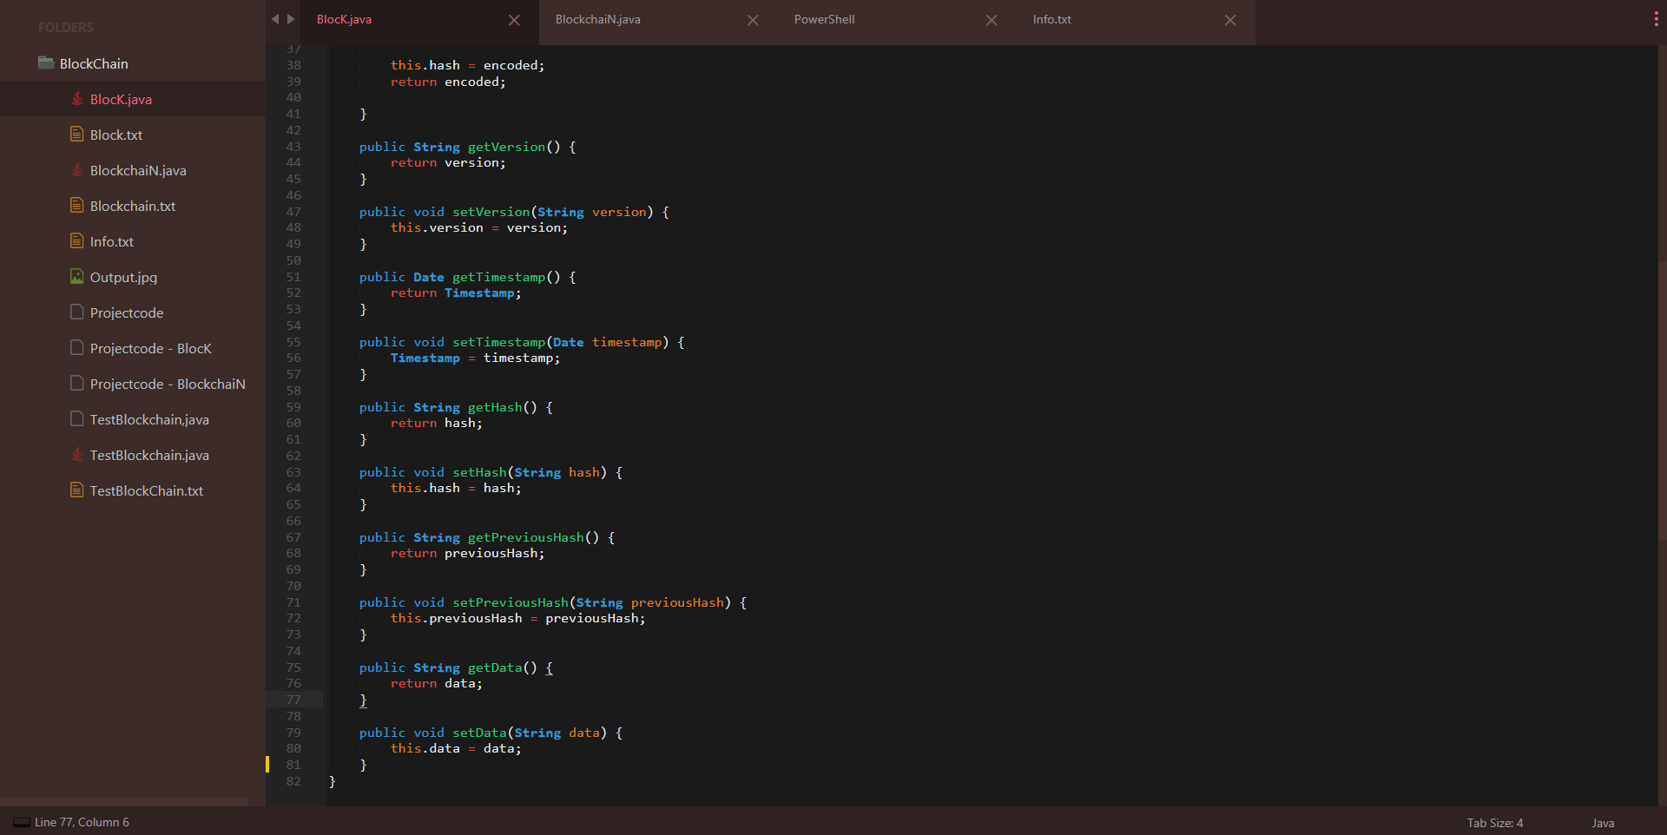

Slide 16
BlockchaiN.java
……………………

Slide 17
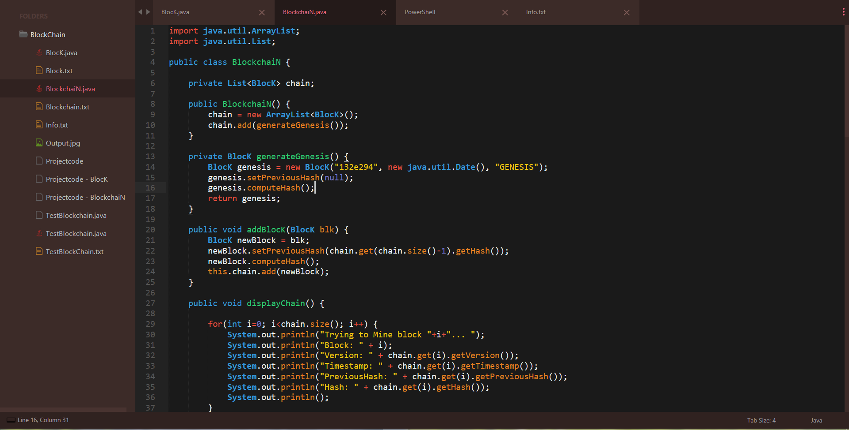

Slide 18
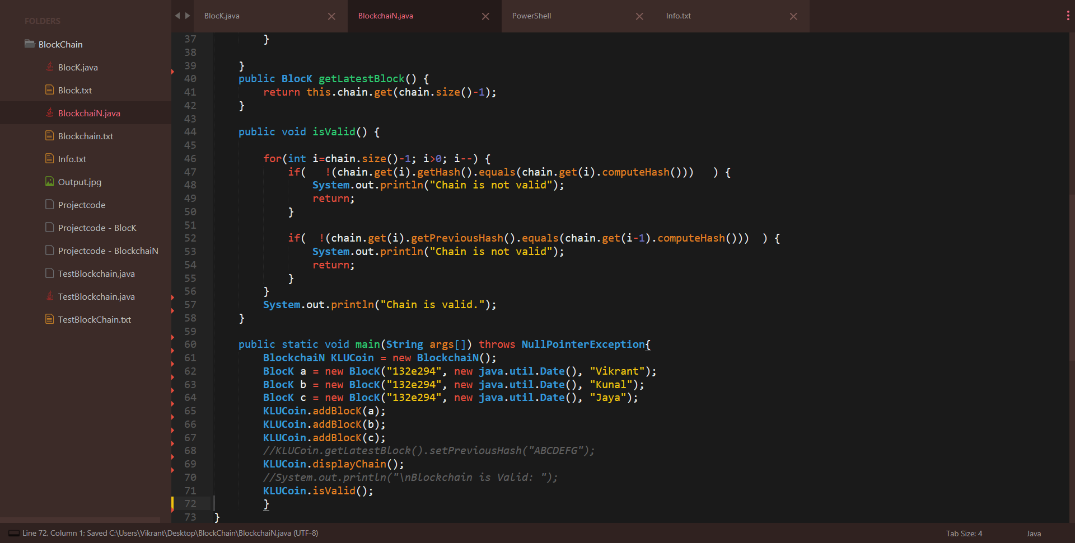

Slide 19
…
Output

Slide 20
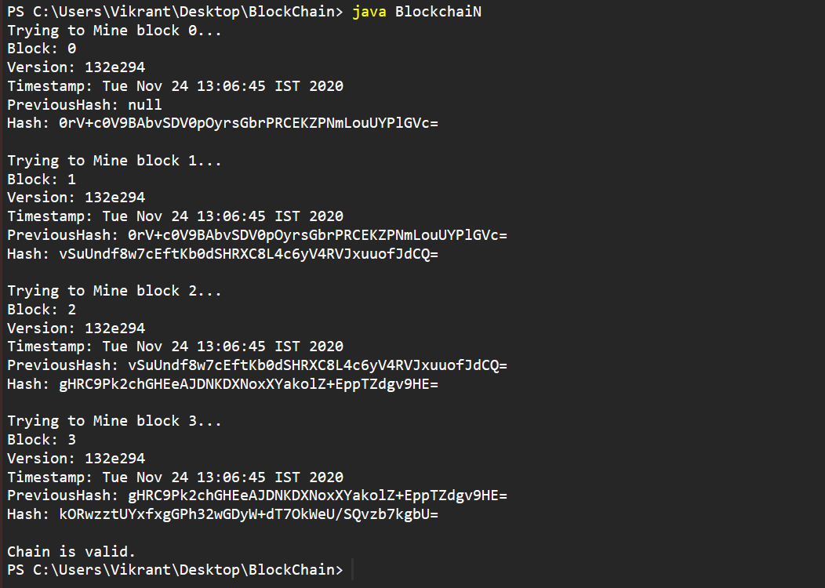

Slide 21
CONCLUSION
So far Implementing Blockchain using java we can conclude the following contrast ie Blockchain has promise as an approach to developing systems for a number of applications within cybersecurity. In Blockchain-based systems, data and authority can be distributed, and transparent and reliable transaction ledgers created. Some of the key advantages of Blockchain for cybersecurity applications are in conflict with privacy properties, yet many of the potential applications have complex requirements for privacy. Privacy enabling approaches for Blockchain have been introduced, such as private Blockchains, and methods for enabling parties to act pseudonymously, but it is as yet unclear which approaches are suitable in which applications. We explore a set of proposed uses of Blockchain within cybersecurity and consider their requirements for privacy. We compare these requirements with the privacy provision of Blockchain and explore the trade-off between security and privacy, reflecting on the effect of using privacy-enabling approaches on the security advantages that Blockchain can offer.

Slide 22
⛓ Reference
MajorHackingLeague ICON LocalHost ,Azure Learning ,Geeksforgeeks and GitHub…
https://medium.com/programmers-blockchain/create-simple-blockchain-java-tutorial-from-scratch-6eeed3cb03fa
https://medium.com/programmers-blockchain/creating-your-first-blockchain-with-java-part-2-transactions-2cdac335e0ce
https://medium.com/@essentia1/50-examples-of-how-blockchains-are-taking-over-the-world-4276bf488a4b
https://www.javatpoint.com/blockchain-tutorial

Slide 23


THANK YOU✌
VIKRANT
KUNAL
JAYACHANDRAPAL
🔗BLOCKCHAIN🔗
Using Java

